Slide 1

Multidimensional Arrays
SoftUni Team
Technical Trainers
Software University
https://softuni.bg/

Slide 2
Have a Question?
sli.do
#cpp-advanced
Notes:
2

Slide 3
Table of Contents
Multidimensional Arrays
Creating
Accessing Elements
Reading and Printing
C-style Arrays as Function Parameters
"Multidimensional" Containers
Row-Major Order
3
Notes:
3

Slide 4
Multidimensional Arrays
Definition and Usage

Slide 5
What is Multidimensional Array?
Array is a systematic arrangement of similar elements
Multidimensional arrays have more than one dimension
They are just normal arrays which are indexed differently
Most-common usage: making a matrix / table
R OWS | COLS
 | [0][0] | [0][1] | [0][2] | [0][3] | [0][4]
 | [1][0] | [1][1] | [1][2] | [1][3] | [1][4]
 | [2][0] | [2][1] | [2][2] | [2][3] | [2][4]
Col Index
Row Index
5

Slide 6
Accessing Multidimensional Arrays
Accessing
Accessing elements is done with one indexer per dimension
Multidimensional arrays represent a rows with values
The rows represent the first dimension and the columns - the second
Index of row
Index of column
int element = matrix[1][0];
1st element of the 2nd row

Slide 7
Declaring Multidimensional Arrays
Declaring: add a size for each additional dimension
int matrix[2][3];
First dimension can omit size if it is a function parameter
int matrix[][3];

Slide 8
Using Multidimensional Arrays
Each n-dimention is an array with (n - 1) dimensions
int matrix[][3] =
{ { 11, 12, 13 },
{ 21, 22, 23 }
};
If no initializer {} brackets, values are undefined
If more elements than initialized, others are defaults
int cube[2][3][4] =
{ { {111, 112, 113, 114}, {121, 122, 123, 124}, {131, 132, 133, 134} }, { {211, 212, 213, 214}, {221, 222, 223, 224}, {231, 232, 233, 234} }
};

Slide 9
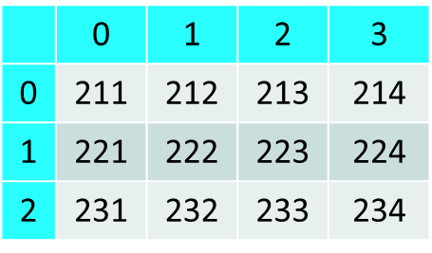
Reading and Printing Matrices
Matrices and Higher Dimensions

Slide 10
Reading a Matrix
int main()
{
int a[5][5];
int row, col;
cin >> row >> col;
for (int i = 0; i < row; i++)
{
for (int j = 0; j < col; j++)
{
cin >> a[i][j];
}
}
return 0;
}

Slide 11
Printing a Matrix
int main()
{
int a[5][5];
int row, col;
cin >> row >> col;
for (int i = 0; i < row; i++)
{
for (int j = 0; j < col; j++)
{
cin >> a[i][j];
}
}
for (int i = 0; i < row; i++)
{
for (int j = 0; j < col; j++)
{
cout << a[i][j] << " ";
}
cout << endl;
}
return 0;
}

Slide 12
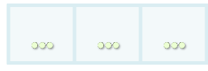
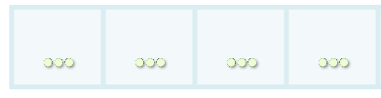
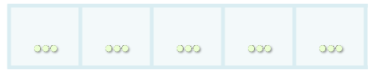
Passing Arrays to Methods

Slide 13
Passing Arrays to Methods
Arrays can be passed to methods
The first dimension could be skipped
void foo(int arr[3][5])
void foo(int arr [][5])

Slide 14
"Multidimensional" Containers
We know std::vector can contain any type
Any type with a default constructor
int, double, char, string, even another std::vecto
Often containers will contain other containers
Example: a vector of vectors (2D), a vector of vector of vectors (3D)
Element access is the same code as with multidimensional arrays
Note: no row-major order (not contiguous in memory)

Slide 15
std::array & std::vector
Multidimensional arrays could be created with
std::array
std::vector
If we know the needed size in advance we use std::array
Arrays' data is allocated on the stack

Slide 16
std::array Matrix
const int rows = 3;
const int cols = 5;
// create an empty matrix
std::array<std::array<int, cols>, rows> matrix;
//initialize a matrix
std::array<std::array<int, cols>, rows> matrix
{
{ 0, 1, 2, 3, 4 },
{ 1, 2, 3, 4, 5 },
{ 2, 3, 4, 5, 6 }
};

Slide 17
std::vector Matrix
If we don't know the size we use a std::vector
//create an empty matrix
std::vector<std::vector<int>> matrix;
//initialize a matrix
std::vector<std::vector<int>, rows> matrix
{
{ 0, 1, 2, 3, 4 },
{ 1, 2, 3 }
{ 2, 3, 4, 5, 6, 7, 8 }
};
When we have vectors - the matrix can have any size

Slide 18
Working with 2D std::vector
Working with 2D std::vector when dealing with methods
A method can return a populated matrix
A method can accept the 2D std::matrix as a normal function parameter
std::vector<std::vector<int>> readMatrix()
void foo(std::vector<std::vector<int>> matrix); // makes a copy
void foo(std::vector<std::vector<int>>& matrix); // passed by reference

Slide 19
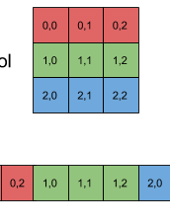
Row-Major Order in Multidimensional Arrays

Slide 20
Row-Major Programming Language
In row-major order
The consecutive elements of a row reside next to each other, whereas the same holds true for consecutive elements of a column in column-major order
C++ is Row-Major Based Programming Language

Slide 21

Summary
Multidimensional arrays
Have more than one dimension
Two-dimensional arrays are like tables with rows and columns
Most-common usage: making a matrix or a table
C++ is Row-Major Based Programming Language
Notes:
21

Slide 22










Questions?

Slide 23











SoftUni Diamond Partners

Slide 24
Trainings @ Software University (SoftUni)
Software University – High-Quality Education, Profession and Job for Software Developers
softuni.bg, about.softuni.bg
Software University Foundation
softuni.foundation
Software University @ Facebook
facebook.com/SoftwareUniversity
Notes:
24

Slide 25

License
This course (slides, examples, demos, exercises, homework, documents, videos and other assets) is copyrighted content
Unauthorized copy, reproduction or use is illegal
© SoftUni – https://about.softuni.bg/
© Software University – https://softuni.bg
Notes:
25

